Slide 1



New Short-Range Tests of Gravity
Jennifer James and Janessa Slone
Faculty: Dr. Quentin Bailey
Embry-Riddle Aeronautical University
College of Arts and Sciences | Department of Physics and Astronomy
Sponsored by the Arizona/NASA Space Grant

Slide 2
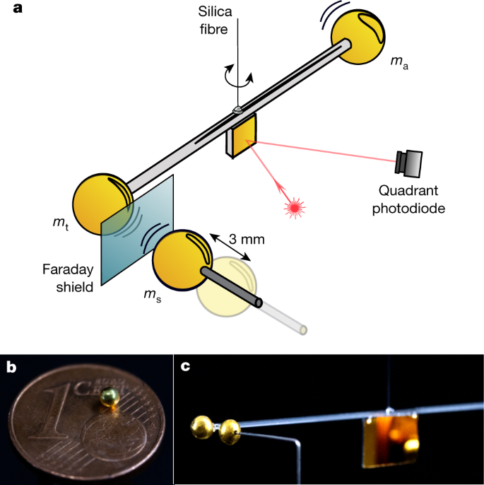
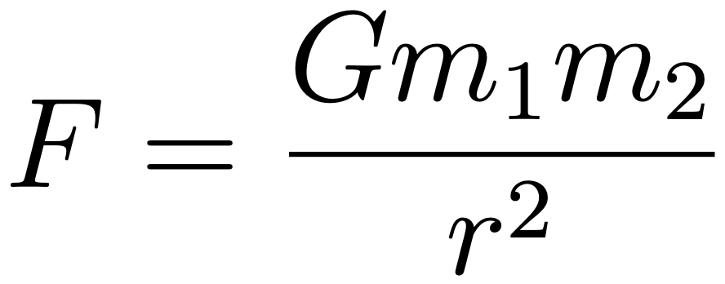
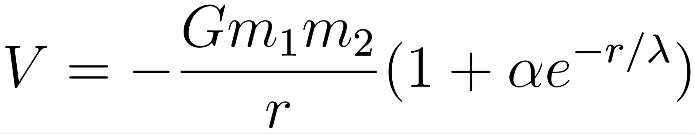
Overview
New Short-Range Tests of Gravity
Theoretical physics project
Goal: calculate modifications to the Newtonian gravitational force
The modified equations can be used for analysis by experimental groups
Newton’s inverse square law of gravity still valid
Many theoretical ideas of unification may manifest as small “violations” of General Relativity and Newtonian Gravity
We will use the Standard-Model Extension (SME) test framework
Allows for arbitrary Lorentz-symmetry violations
Experimental Short-range Tests of Gravity have been carried out worldwide to search for modifications to Newtonian gravity
Ex: Yukawa “correction”
.
Short-Range Test of Gravity (Westphal et al, Nature 2021)
Colladay and Kostelecky, “CPT violation and the standard Model,” Phys. Rev. D 1997+
Arkani-Hamed et al, “The Hierarchy problem and new dimensions at a millimeter,” Phys. Lett. B 1998+
Hoyle et al, “Sub-millimeter tests of the gravitational inverse-square law, Phys. Rev. D 2004 +,
Notes:
Newton’s inverse square law of gravity, which proceeded General Relativity, remains valid as a special case of GR where fields are weak and masses move slowly.

Slide 3

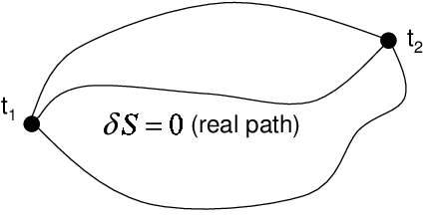
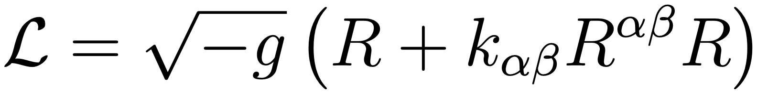
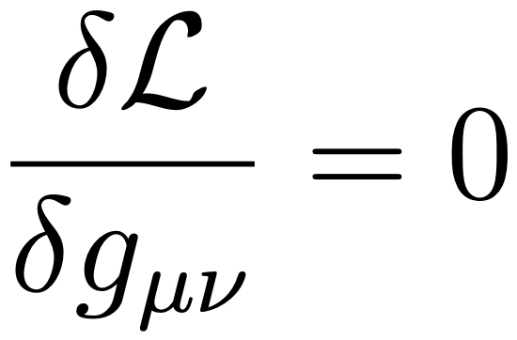
Plan of Action
Background problems using “A First Course in General Relativity,” (Schutz) book to understand
  Tensors, 4-momentum, Christoffel Symbols, etc.
Understand using the action principle with Lagrangian functions
  Derived Maxwell’s Equations using the lagrangian for E&M
  Found the Proca Equation (massive photon) using Euler-Lagrange Equations
Where A is the 4-Vector potential, m is mass, j is 4-current density
Next steps:
  Obtain the field equations from the SME Lagrange density for the gravity sector
Gauthier, Jean-Yves et al (2008), “Nonlinear Hamiltonian modelling of magnetic shape memory alloy based actuators”
Bailey et al, “Short-range gravity and Lorentz violation,” Phys. Rev. D 2015

Slide 4
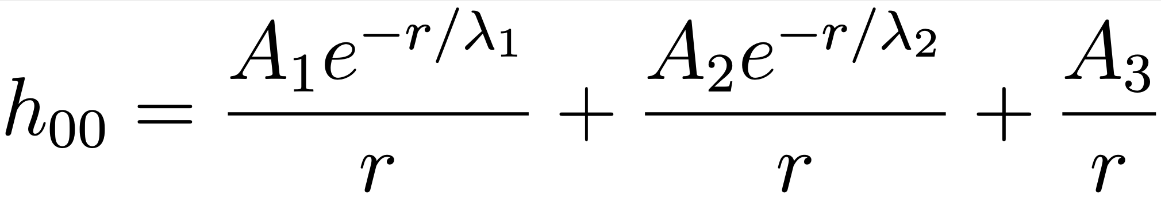
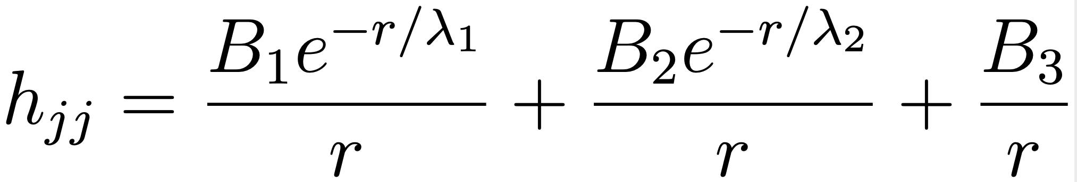
Plan of Action Cont..
The field equations give two coupled equations for two fields
Jennifer using coupled equations to find the general solution (using Green functions):
Solve for the coefficients and the lambda’s in terms of the coefficients k00 and ktr
Green function methods described in, for example, Arfken and Weber, “Mathematical Methods for Physicists,” 2005

Slide 5
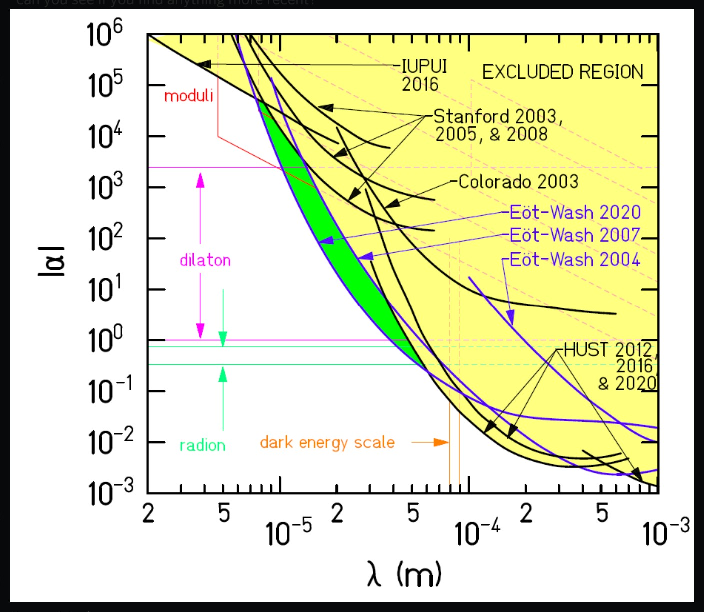
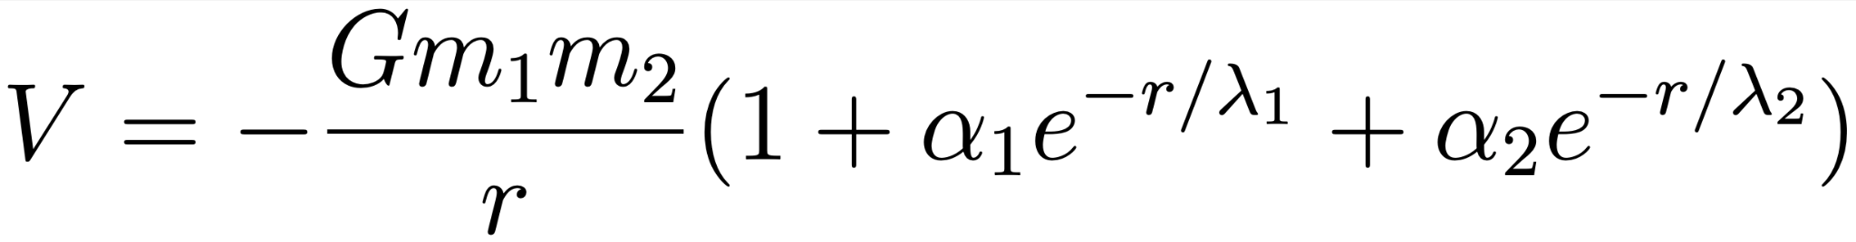
Preliminary Results
The NEW solution takes the form
Compare with the Yukawa potential
New solution has 4 parameters including two length scales instead of 1
J.G., Lee, https://doi.org/10.48550/arXiv.2002.11761

Slide 6
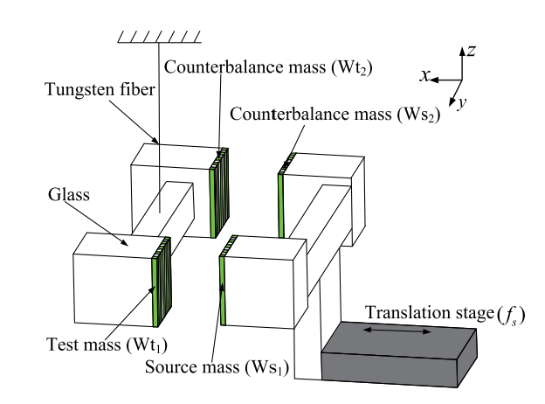
Experimentation
A Short-Range Gravity Experiment from the HUST (Huazhong University of Science and Technology) group in China. This group has so far tested the SME framework in another limit, found no evidence of Lorentz violation so far.
Shao et al, “Enhanced sensitivity to Lorentz invariance violations in short-range gravity experiments,” Phys. Rev. D 2016.
Shao et al., “Search for lorentz invariance violation through tests of the gravitational inverse square law at short ranges,” Phys. Rev. D, 91 2015
Notes:
Schematic drawing of the experimental design. All the test and source masses are designed with periodic striped geometry in the z direction. The separation between the tungsten test and source masses is modulated with a translation stage with frequency fs, and the sensitiv- ity of the pendulum is calibrated gravitationally with a copper cylinder rotated nearby at frequency fc. TO TEST OTHER RESULTS

Slide 7
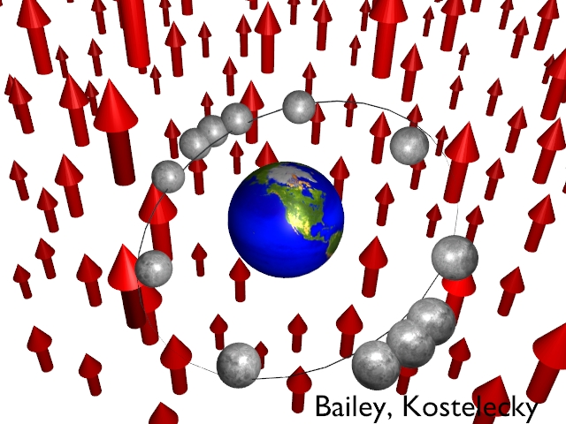
Summary/Future Plans
Goal: study new corrections to Newton’s inverse square law coming from an underlying theory of physics
We are finding the first “exact” solutions for short-range gravity in the SME theoretical test framework
Experimenters can search for these new types of forces to complement existing studies
Jennifer graduates May 2022
Janessa plans to continue working on New Short-Range Tests of Gravity through the Summer of 2022
Manuscript in preparation for publication on this work (summer 2022 expected)
Link to more information on this and related research: http://mercury.pr.erau.edu/~baileyq/res.html

